Slide 1

Object Oriented Programming HTML5 Tutorials Tutorial #4 : A sample "map" object
Department of Computer Science and Information Engineering
Shuo-Han Chen (陳碩漢), shchen@csie.ntut.edu.tw
Hong-Yue Technology Research Building 1223
F 09:10 - 12:00
Notes:
Good Afternoon everyone
I am Shuo-Han Chen, a postdoctoral research fellow at Academia Sinica
It is a great honor to be invited by the department for being here today

Slide 2

HTML5 Game Framework 使用說明
Tutorial 4: 利用陣列建立遊戲地圖
Notes:
Thank you for listening. Now, I would like to end today’s talk by the Q & A time.

Slide 3

1.參考練習 1加入兩張圖片
2.新增一個 js 檔，命名為 GameMap.js，並建立地圖陣列

Slide 4
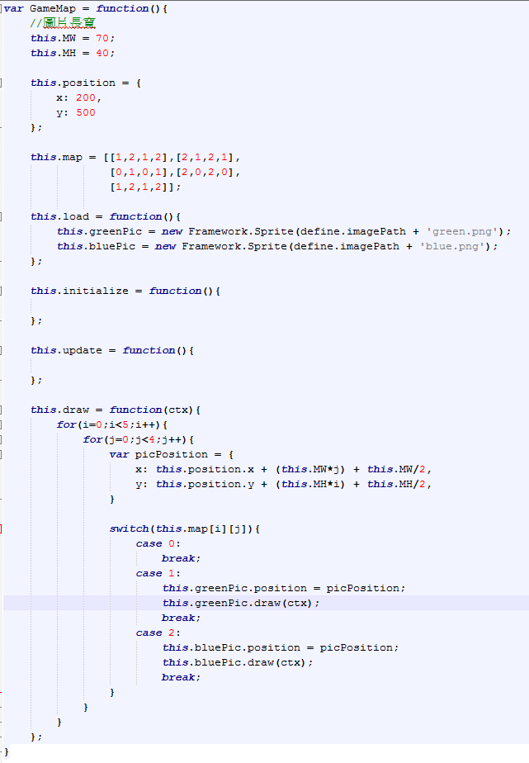

Slide 5
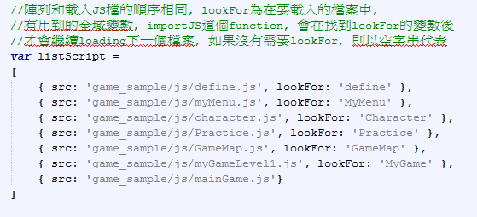

3.在 loadGame.js中加入 GameMap.js
4.在 myGameLevel1.js的 load function內建立物件

Slide 6
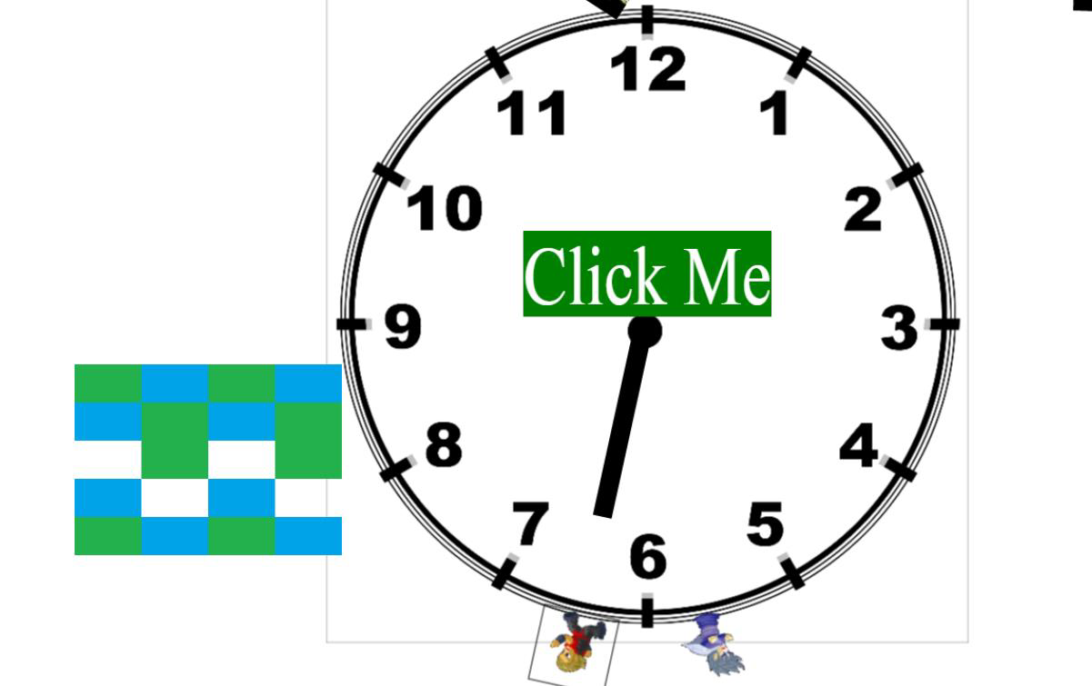
5.執行結果

